Slide 1

Analysis of Ames, Iowa’s Neighborhood Property Values
based on building variety and property age from 2006-2010

Slide 2
Primary objective
- We’ve been tasked understand the factors that drive home prices, in order to give statistically sound suggestions on how we should allocate dollars earmarked for investment into mortgage-backed securities.
- Data Recap:
Raw data provided covered data from Q1 2006- Q3 2010.
Data contained variables such as neighborhood, lot size, sale price, year built, month and year sold, etc.
Focused on property sales in the greater Ames, Iowa metropolitan area.

Slide 3
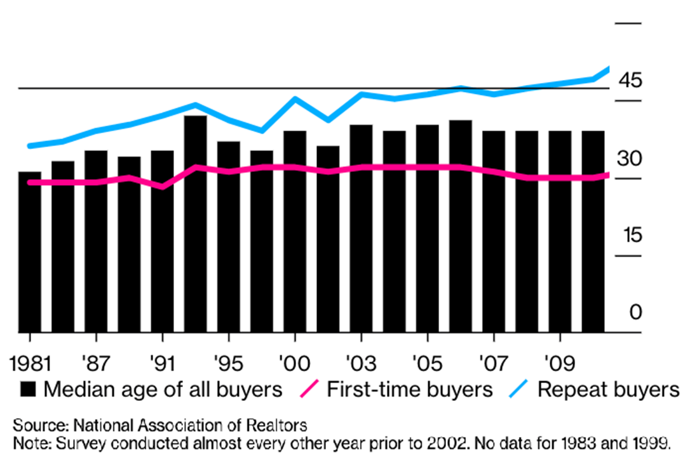
Understanding our clientele
- To better understand the factors pushing sales, we must first understand our clientele’s demand.
- Who are we selling to?
- How does inflation effect the real estate market?
1. Property values will increase
2. The cost of borrowing will increase
3. Rental rates will also increase
2010 Home Buyer Stats
First-Time Buyer Avg. Age | 30
Repeat Buyer Avg. Age | 49
Median Age of All Buyers | 39

Slide 4
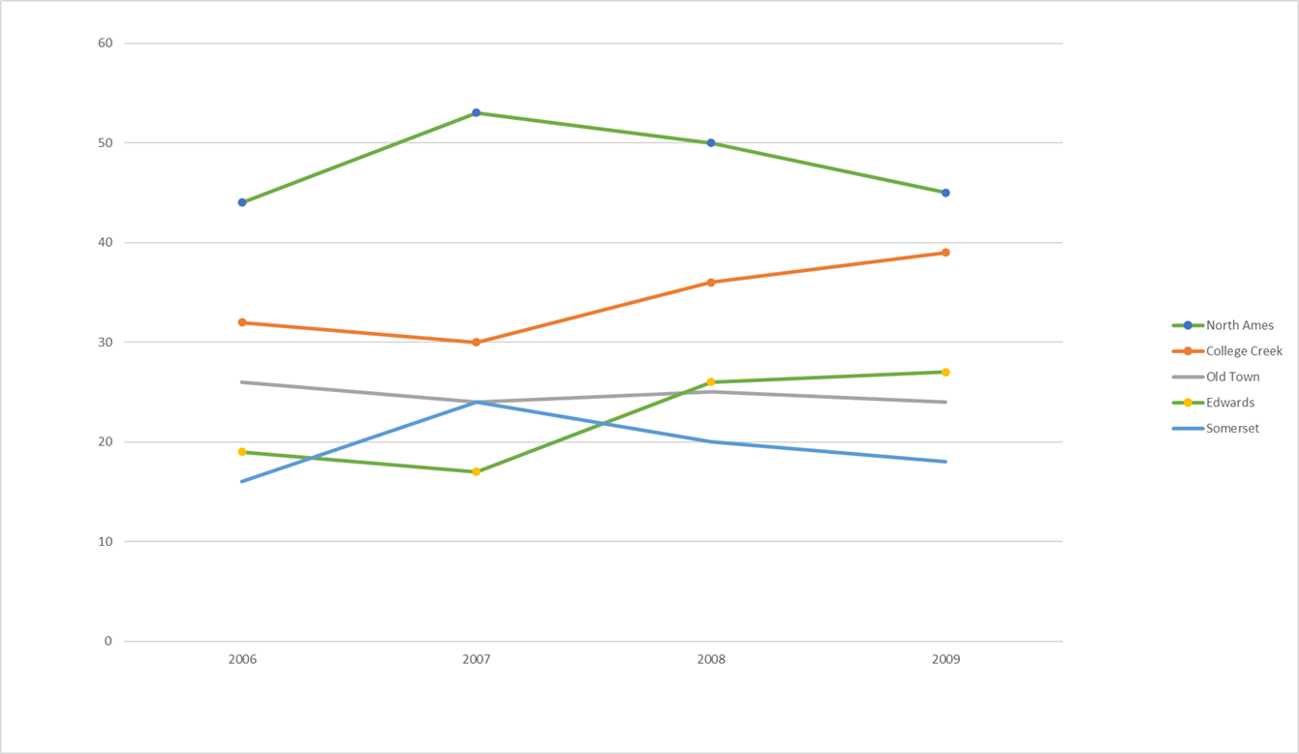
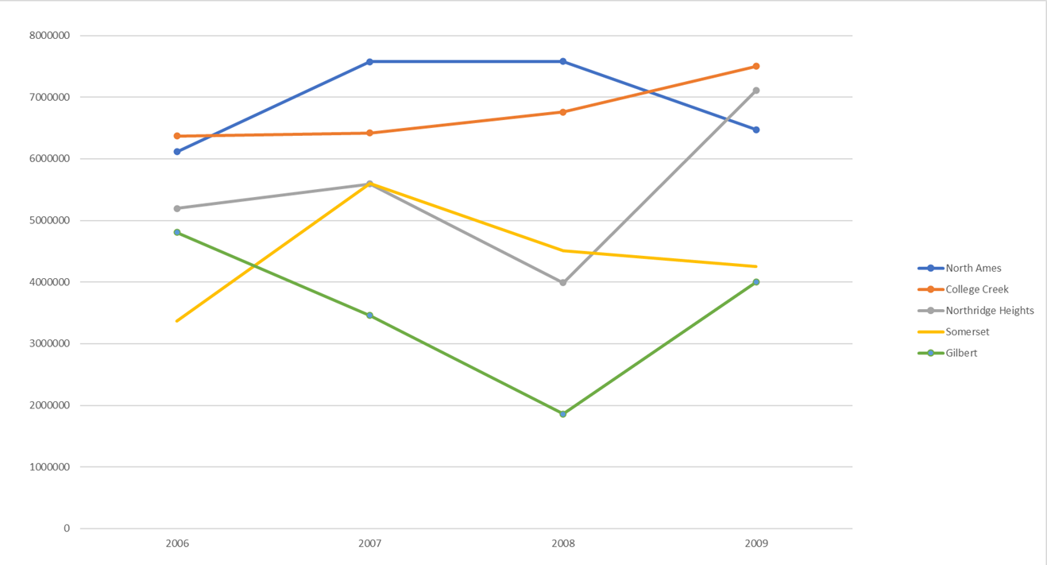
What neighborhoods are they moving to?
Top 5 neighborhoods based on quantity of properties sold 2006-2009
Top 5 Neighborhoods based on total sales 2006-2009

Slide 5
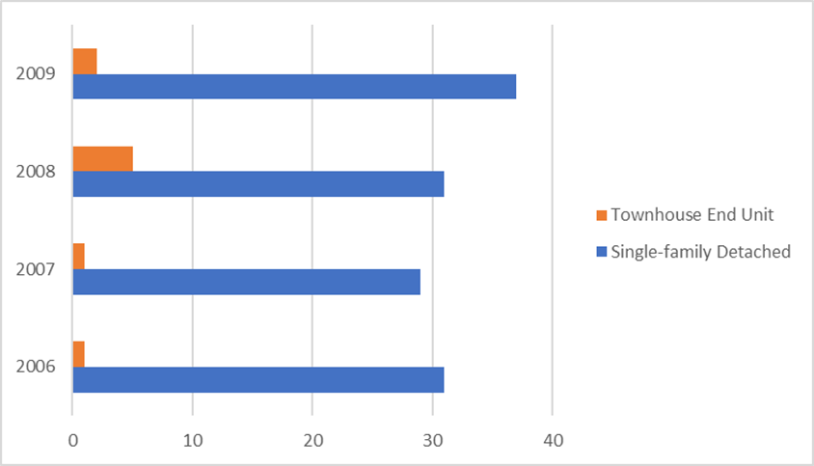
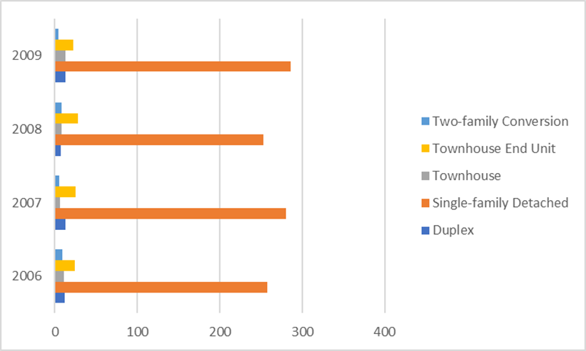
Factor 1: Property Type
- Single family houses are historically preferred by our clientele.
College Creek property-type sale distribution 2006-2010
Overall property-type sale distribution 2006-2010

Slide 6
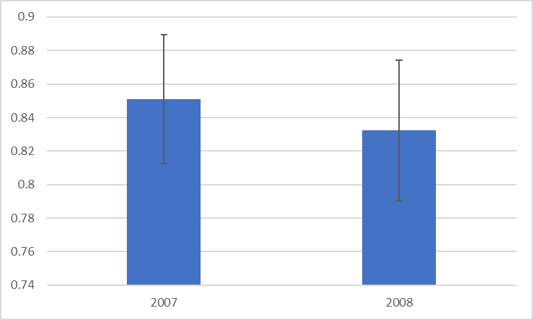
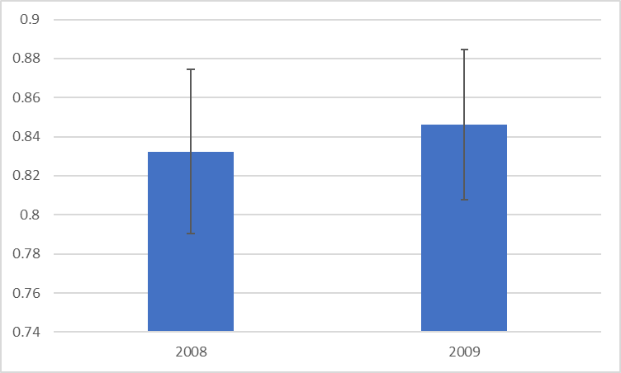
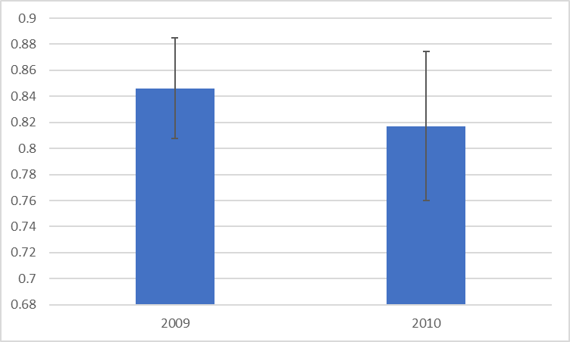
Statistically it checks off
While running year/year tests for the previous three years, we can statistically confirm that there
is no change in demand for single family homes, therefor making them a safe investment for us.
For 2009 alone, single family homes made up 87.5% of our sales at a total of $53,085,456.
If the rate of which single family homes sell continue to grow at the same rate as the previous year, we can expect an increase to our revenue by $9,442,013.15

Slide 7
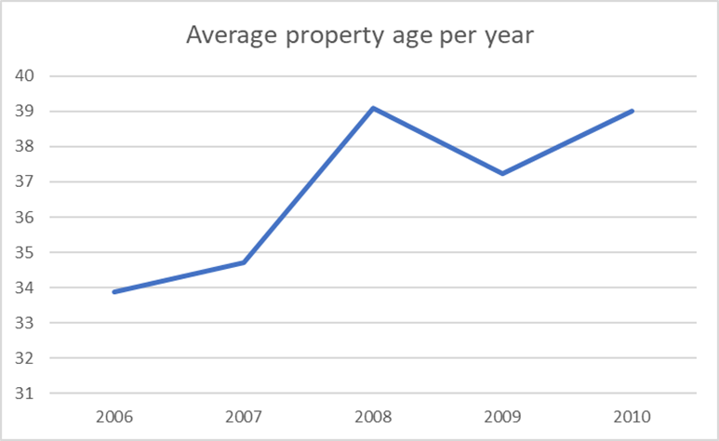
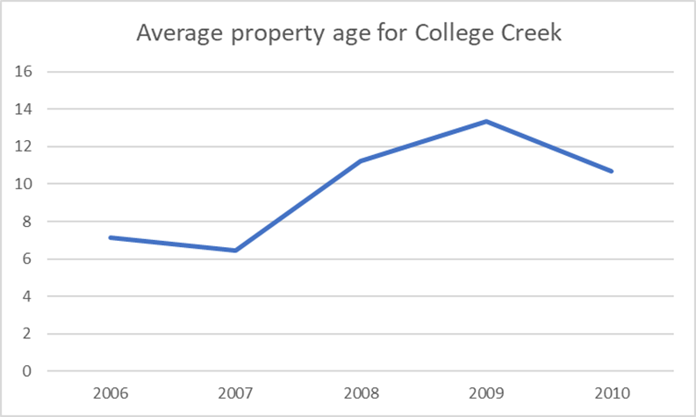
Factor 2: Property Age
Properties under the age of 40 at the time of sale are historically preferred by our clientele.

Slide 8
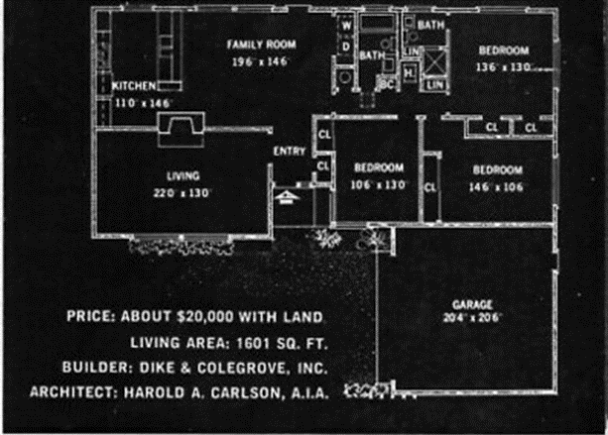
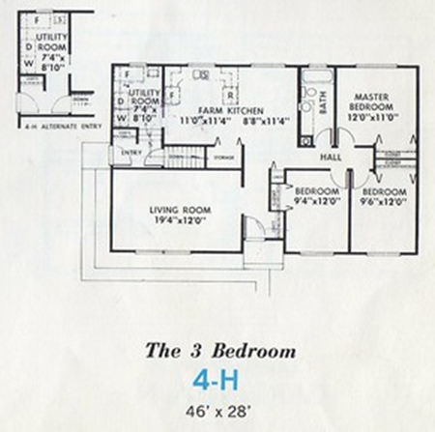
What’s so special about the 70’s
Check out blueprints of 1970s-style homes and you’ll see something that looks quite familiar:
a living room that flows into a dining room that’s either open to or closely connected to the kitchen.
Architects in the ‘70s were clearly ahead of their time, as this sort of setup is still super popular today.
Many of the plans also include huge, floor-to-ceiling windows and French doors that open onto sprawling porches, two features that sell homes to this day.

Slide 9
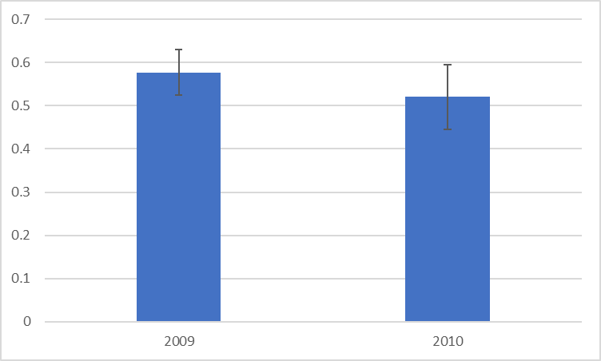
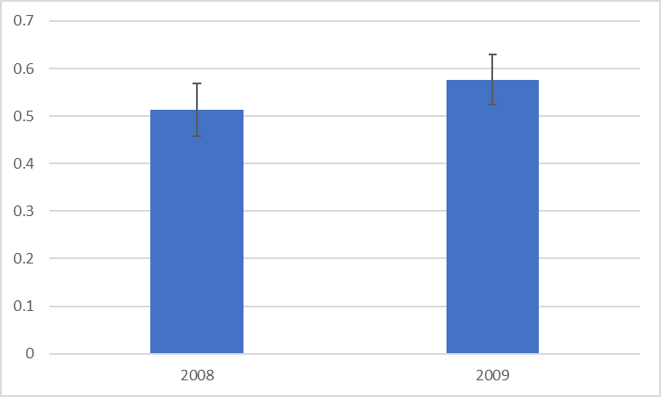
Once again, statistically it checks off
By performing year/year analysis for the popularity of houses under the age of 40, going two years back, we can statistically confirm the demand for this factor.

Slide 10
Final Suggestions
- Invest in single family homes.
- Invest in properties under the age of 40.
- capture more data on our clientele.

Slide 11
?

